Slide 1
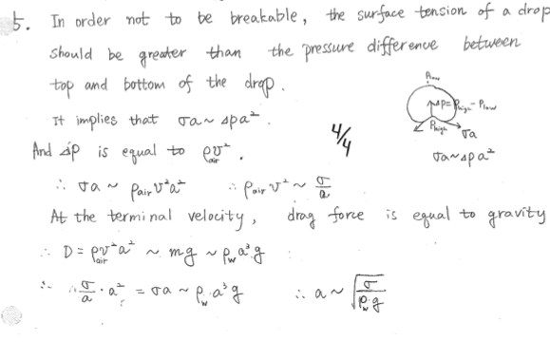
Activity 1: solve for size and speed of a drop.

Slide 2
Useful units for calculations
Remember: dyne = 1 g cm/s² (force in cm-g-s units) = 10⁻⁵ Newtons. Using cgs units is easiest for calculations with small insects, as the values are often order-one.
Density of air ρ = 10⁻³ g/cm³
Density of water ρ_{w} = 1 g/cm³
Gravity g ≈ 1000 cm/s²
Surface tension σ = 70 dynes/cm

Slide 3
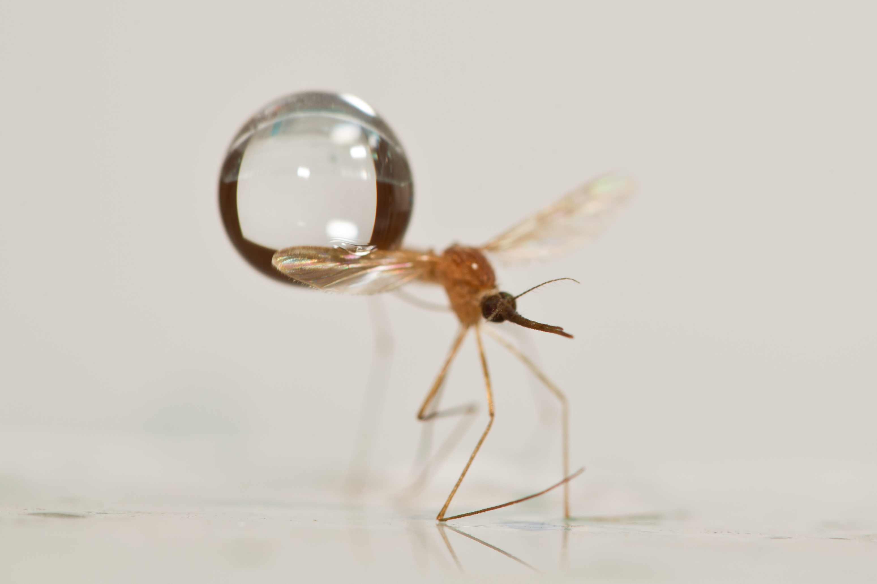
Answer 1: Raindrops heavier and faster than mosquitoes
raindrop radius ~ 1 - 4 mm
raindrop mass ~ 2 - 50 mosquitoes
raindrop speed ~ 5 - 9 m/s >> mosquito speed (1 m/s)
*Clements, A. The sources of energy for flight in mosquitoes. Journal of Experimental Biology 32, 547 (1955).
**Savile, D. & Hayhoe, H. The potential effect of drop size on efficiency of splash-cup and springboard dispersal devices. Can. J. of Bot. 56, 127–128 (1978).
Notes:
As we consider the two opponents, we see mosquitoes are comparable in size to drops, but drops have a mass 2-50 times a mosquito’s mass and a much higher speed.

Slide 4
Activity 2: What is frequency of impacts for a flying mosquito?
This is a problem of mass conservation. Rain intensity I is given in the units of cm/hour. We must convert this unit into a number of drops that falls on top of the mosquito per second.
This problem is related to the the first problem in “flying circus of physics”, which asks is wetter to run or walk through the rain. Here we recognize that mosquitoes fly so slowly that impacts on the mosquito’s frontal area are negligible compared to that on top.
So consider only drops falling atop the mosquito where plan-view area of wings and legs is A_{m}. This area is given by considering all drops that impact or even graze the legs (See diagram on next page where an area is sketched out that is one drop radius wider than legs and body). Students should estimate this area A_{m} to 1 significant digit.
First convert I to cm per second. Then, every second, we consider the volume of drops that fall to fill a volume that is A_{m} wide and I tall. We can convert this into a mass of fluid falling per second using the density of water ρ used in activity 1. Lastlly, we can find frequency of drops f by remembering each drop has a fixed volume m calculated from activity 1.

Slide 5
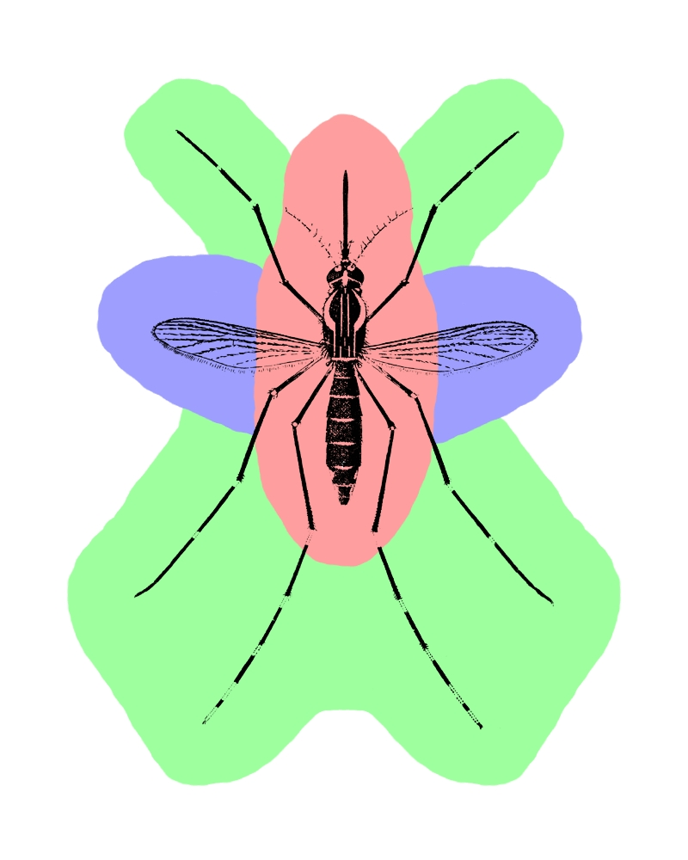
Activity 2 solution: Frequency of impacts
impact area A_{m} ~ 30-40 mm².
rain intensity I ~ 50 mm/hr
frequency of impacts: once every 25 sec
Direct impact (red) zone composes 1/4 total area.
Glancing Impacts are 3X more likely.
Notes:
How often does a mosquito get hit by a raindrop? Violent rain falls at a rate of 50 mm/hr, and raindrops can range in size from 10-65 mg on average.
Mosquitoes have an impact area (plan view area) of 30-40 mm^2.
We assume the effects of frontal impacts during flight are negligible.
Therefore, during heavy rain, a mosquito will be struck about every 25 seconds on average.
There are 2 types of impacts. Direct impacts occur when a drop hits the body (red)
Glancing impacts occur when a drop impacts a wing or leg (green).
We find that the direct impact zone accounts for ¼ of the total impact area, and hypothesize that glancing impacts are 3X more likely.

Slide 6
Activity 3: What is force of raindrop after glancing blow
This is a problem of conservation of angular momentum.
The

Slide 7
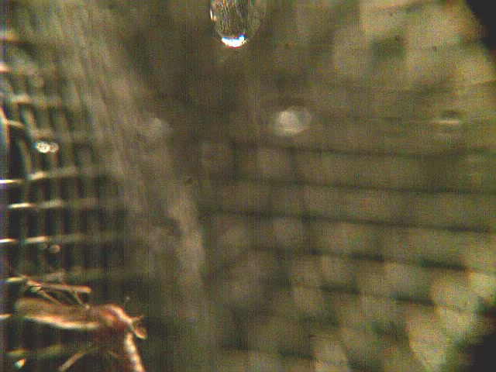
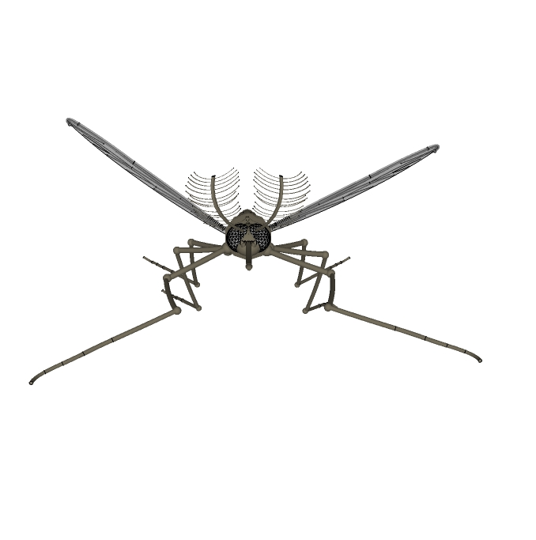
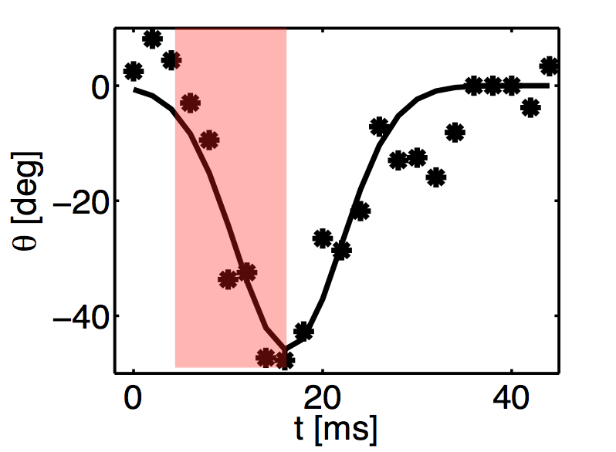
Activity 3: Glancing Blow
θ
F
Kinematics
Low speed impact
Torque applied by the drop: r × F = I α
Geometry: I = m₂R²/2 ≈ 4 x 10⁻⁵ g cm² R = 1 mm
→ F ~ 3.5 dynes ~ 2 mosquito weights
α ~ 10⁴ rad/s²
τ ~ 10⁻ ²s

Slide 8
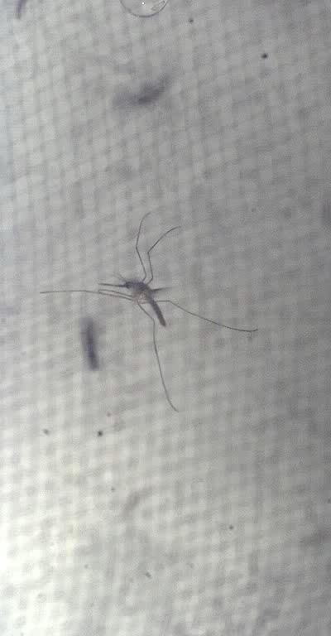
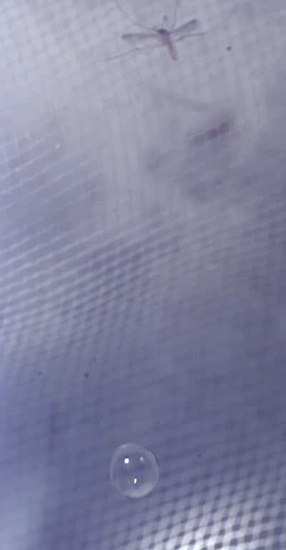

Slide 9
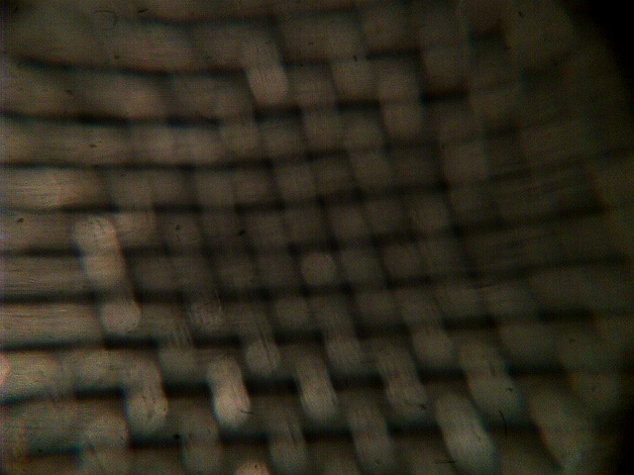

Slide 10
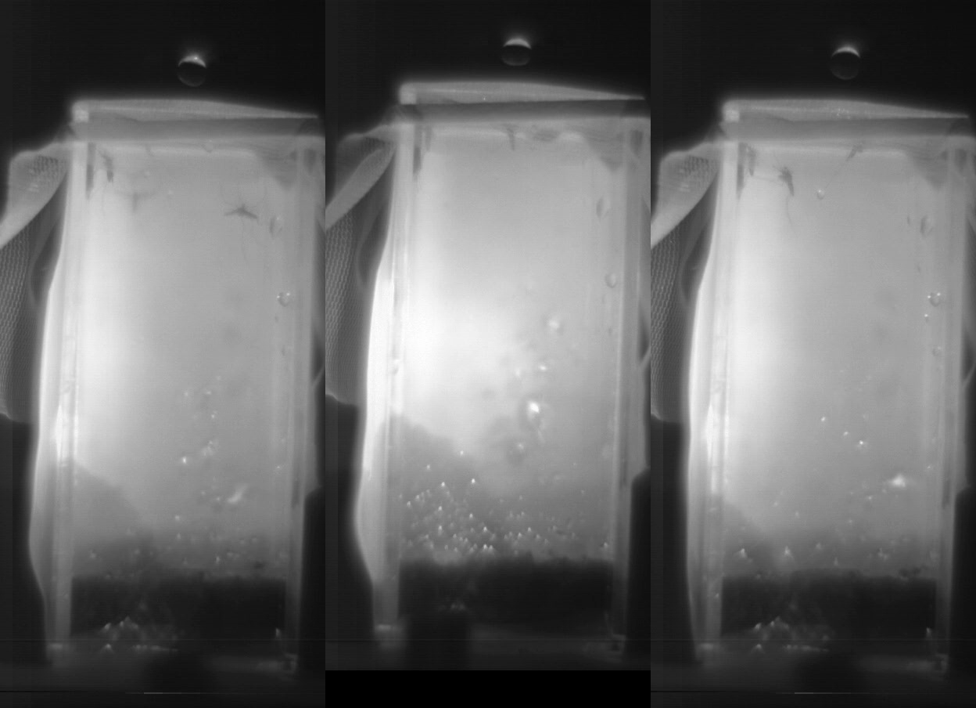
Direct Hit
Inelastic collision—mosquito and drop move as one mass.
Mosquito pushed many body lengths before released.
Notes:
The second type of impact is a direct hit.
A direct hit occurs when a drop hits the center of a mosquito's body in an inelastic collision and acts to push it downward many body lengths.
Eventually, the mosquito and drop separate and the mosquito recovers

Slide 11
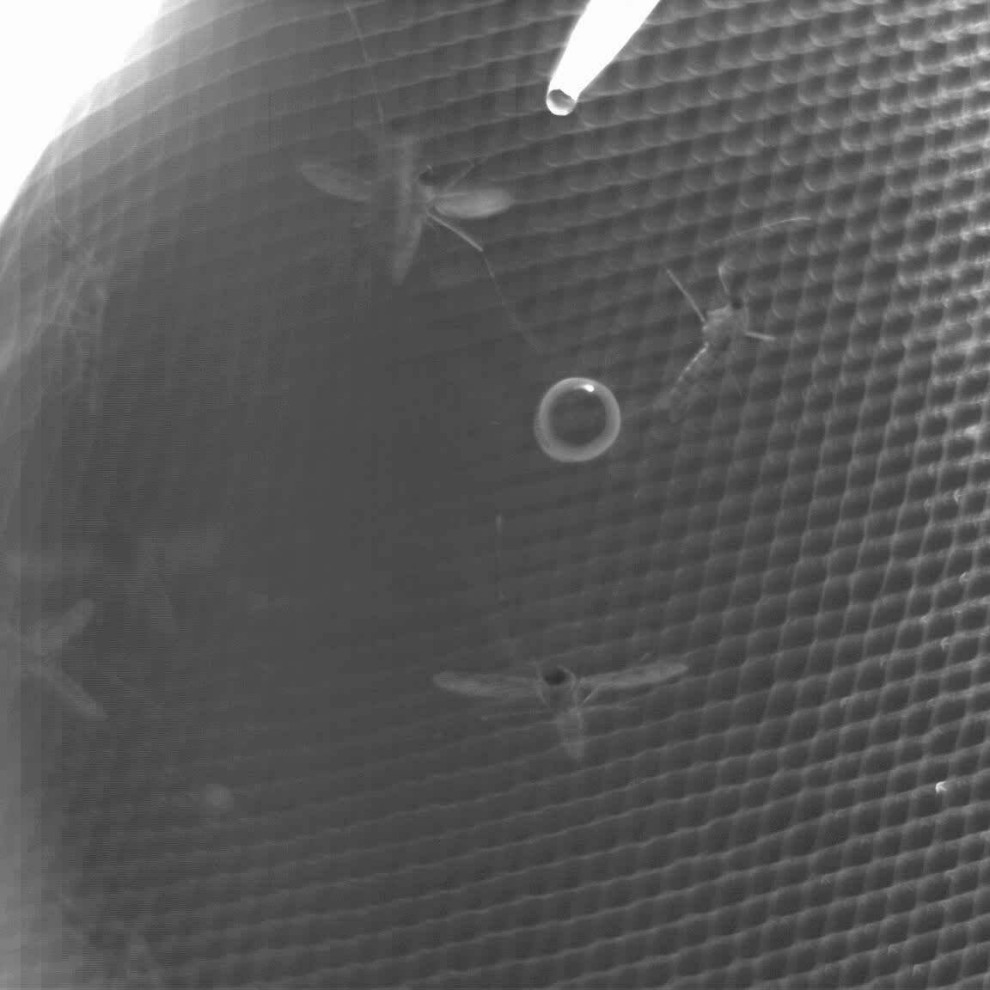

Slide 12
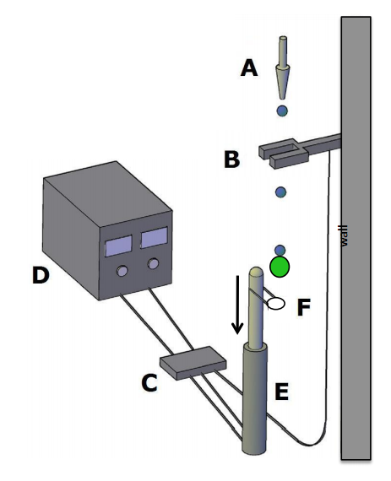



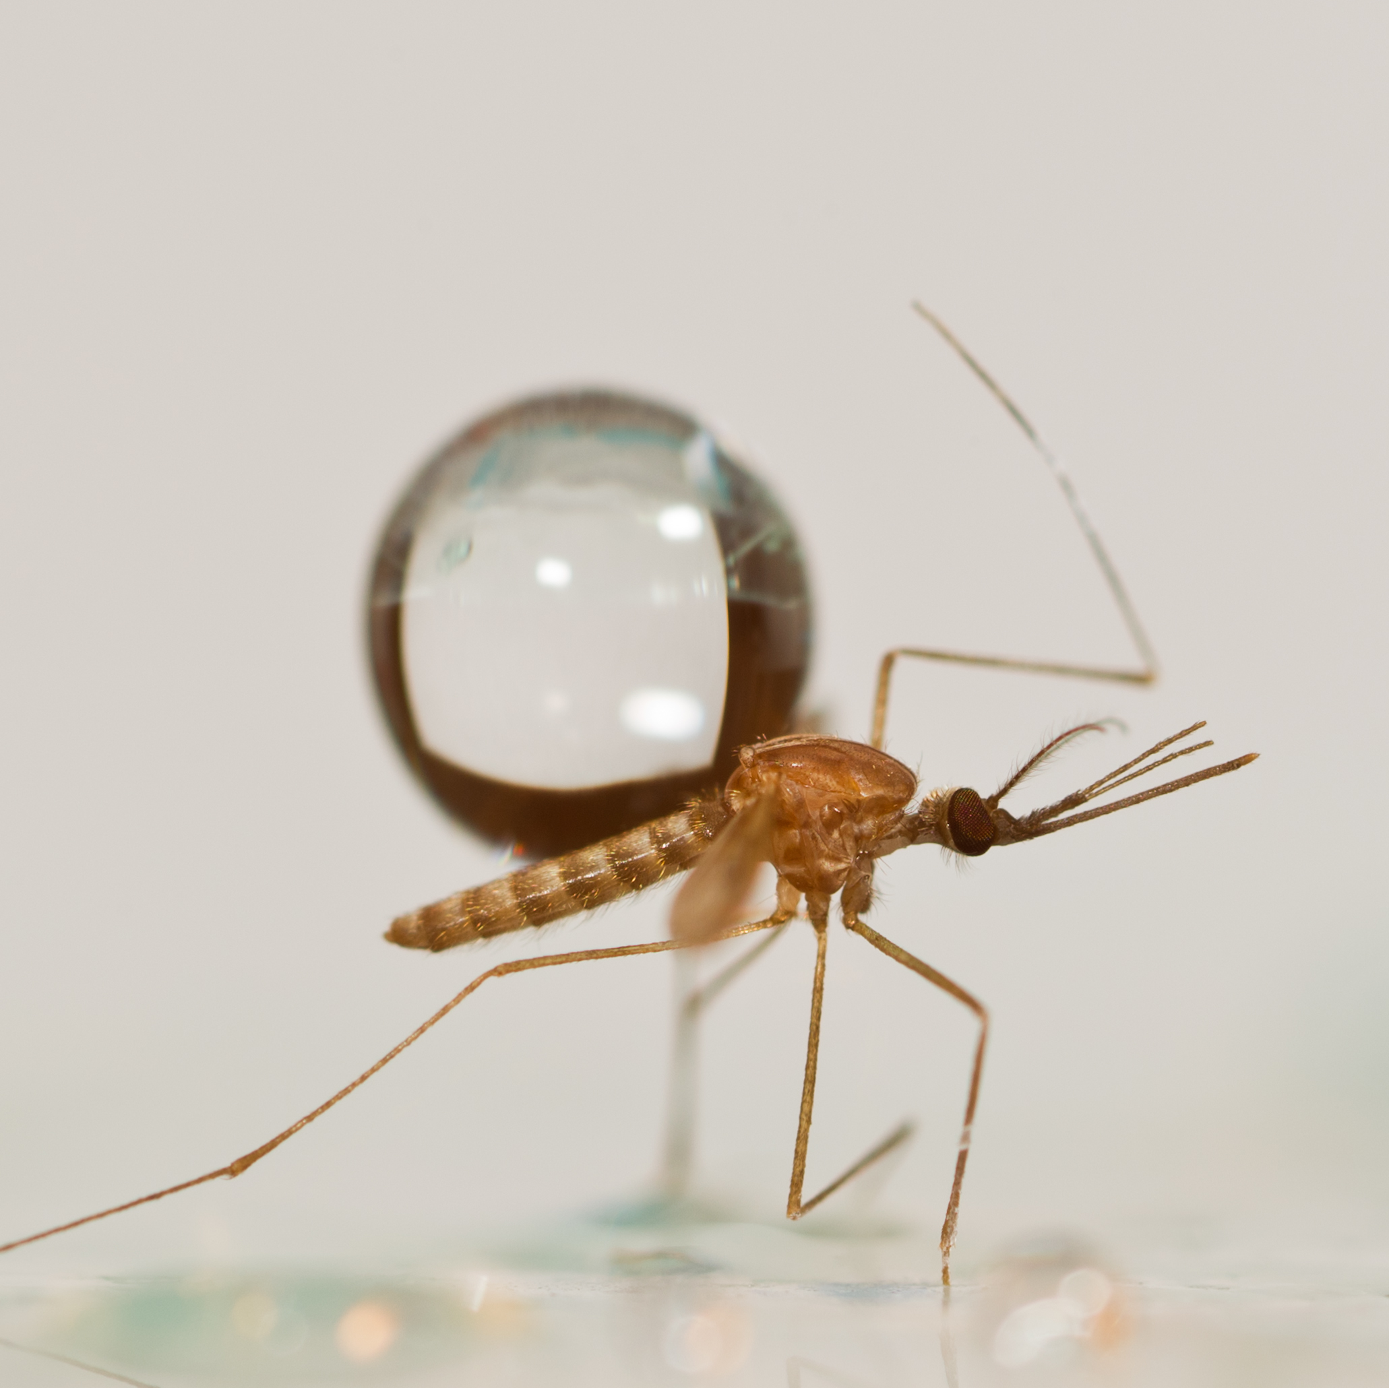
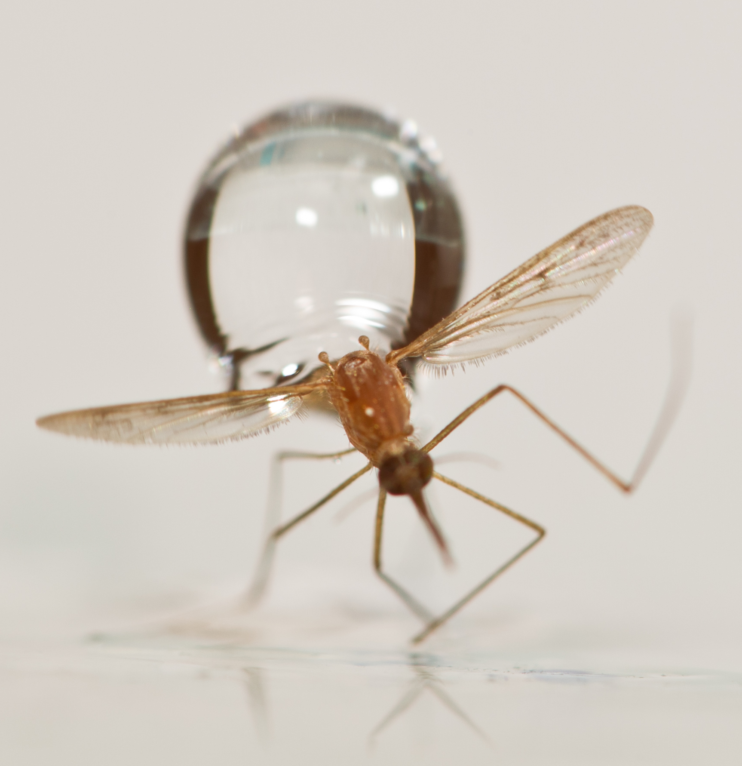
Insect Mimics
Styrofoam “Mosquitoes”
Free body impacts
m₂ ~ 0.4 – 4 mg
Mosquito
m ~ 2 mg

Slide 13
Activity 4: What is the final speed of raindrop-cum-mosquito after impact?
Consider conservation of linear momentum. In particular consider the momentum before and after impact.

Slide 14
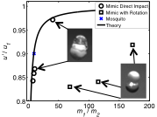
Mosquitoes are so lightweight, raindrops loose very little momentum (2-17%) upon impact.
Inelastic Impact
m₁
u₁
m₁
m₂
m₂
u’
Inelastic Impact
Notes:
This is a simplified diagram of what we see through our camera, where…
From conservation of momentum we can predict the final velocity from this eqn.
The plot shows the velocity ratio versus the ratio of masses. Notice that direct impacts follow the curve well. Departure from the curve happens when a drop glances the object and pulls it downward. Kinetic energy is lost in this rotation. A mosquito, as denoted by the blue X, will slow a drop only by 10%. By comparison, a massive dragonfly will zap 90% of a drop’s velocity.
An insect’s mass determines it’s speed post-impact.
Mosquitoes are so lightweight, raindrops loose very little momentum (2-17%) upon impact. A small momentum transfer signifies small force transfer.

Slide 15
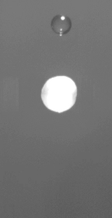
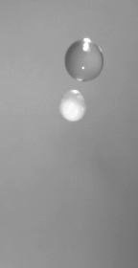
Small drops slow down more
Drizzle
Small Drop (m₁ / m₂ = 9)
→ large deformation
Rain
Large Drop (m₁ / m₂ = 100)
→ slight deformation
R₁ = 1.53 mm R₂ = 2.75 mm
m₁/m₂ = 9
R₁ = 2.225 mm R₂ = 1.65 mm

Slide 16
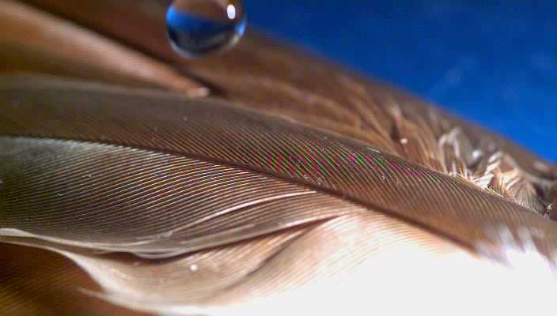
Collisions with body of high inertia
Terminal velocity raindrop on a solid surface:
which is 10⁴ times the weight of a mosquito.
Notes:
Drops impacting solid surfaces transfer most of there initial momentum, generating forces high enough to cause splashing.
The force of impact scales as the drop mass times velocity divided by impact time.
A terminal velocity raindrop will strike a solid surface with a force of 50,000 dynes which is 10,000 times the weight of a mosquito.

Slide 17
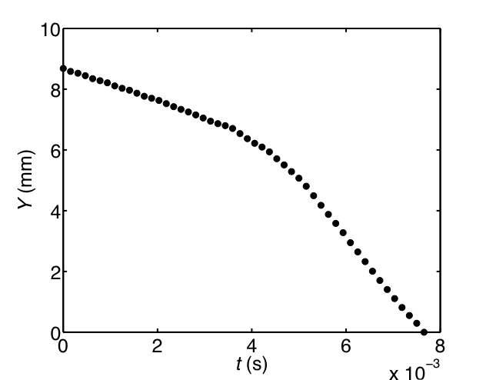
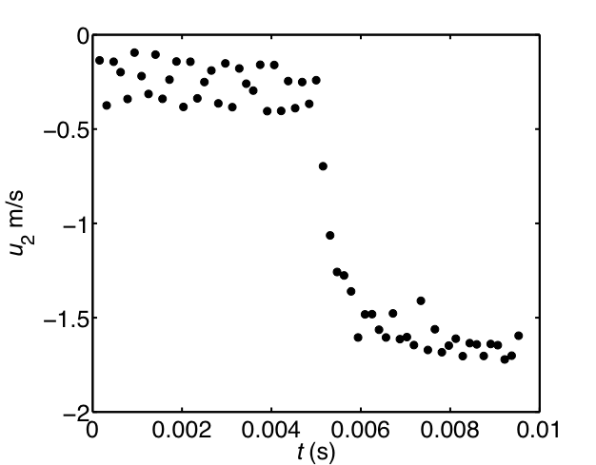
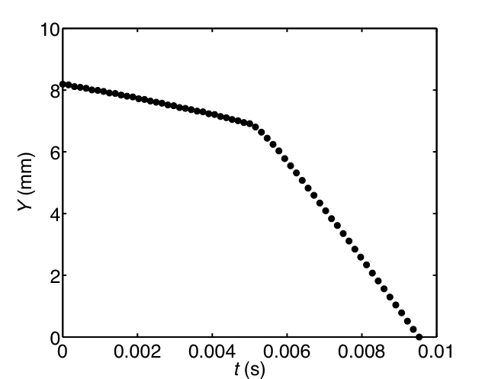
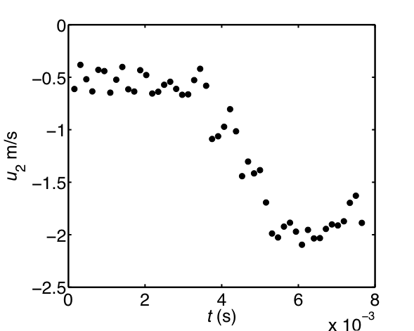
Larger drops apply more force
Position Velocity
Small drop
#g’s = 65
Large drop
#g’s = 95

Slide 18
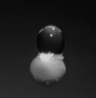
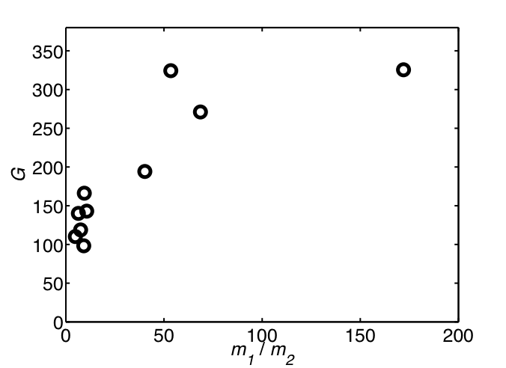
Mosquitoes Accelerate 50-300 G
R₁
light rain
moderate rain
F
heavy rain
flea jumping
human tolerance
Max force: 4000 dynes (flight still possible) – 10,000 dynes (death)
deformation
coefficient:
k = 20
Impact Force
Dimensionless Acceleration
Notes:
In our experiments with slow drop speeds, we saw mimics accelerate 50-300 G. A human’s tolerance to acceleration is about 25 G, and the champions of generating acceleration, fleas, experience 135 G.
To give you an idea of the force involved here: if a 2 dyne mosquito undergoes 300 G, the resulting force is equivalent to the weight of 0.6 grams, about the weight of a feather.

Slide 19
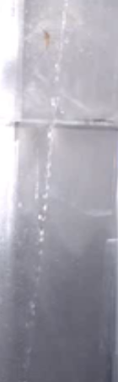
Notes:
Allow me to introduce some areas of future work with this video. There is no way a mosquito would be able to flap it’s wing through a jet. It is simply too lightweight. We will now expand our view to a wider range of insects…

