Slide 1
Tumor Heterogeneity and Chemotherapy Resistance: The Fault in Our Cells
Koch Institute for Integrative Cancer Research
MIT
Notes:
Moved the text box a bit

Slide 2
Do you think all of the cancer cells in a tumor have the same mutations?
Notes:
Moved the text box a little

Slide 3
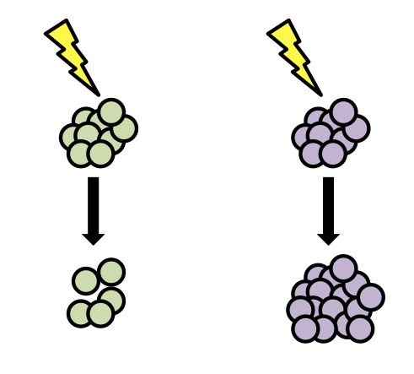
Chemotherapy Resistance
Different tumor cells will respond to chemotherapy in different ways
Sensitive to therapy
Resistant to therapy

Slide 4
Chemotherapy Resistance
Different tumor cells will respond to chemotherapy in different ways
Tumors have cells with many different mutations
How does this affect the tumor’s response to therapy?

Slide 5
Simulation Rules
1. Put 10 of each color bead in your bag.
This is your tumor.
2. In each of 5 cups, put:
This represents division of the cancer cells
Pink | 1 bead
Orange | 1 bead
Yellow | 2 beads
Purple | 2 beads
Green | 3 beads
5 X

Slide 6
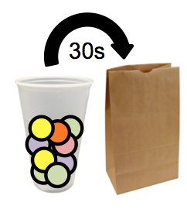
Simulation Rules
Person 1 = Chemotherapy: kill cells by taking them out of the bag one-by-one
Person 2 = Cancer cell division: Every 30 seconds, add one cup of cells
Person 3 = Chemo resistance: When 3 of your resistant cells have been killed, put 2 back in the bag
Look at your instructions to see which cells are resistant for your group
Notes:
Moved some text and photos a little, edited “person 3” a little

Slide 7
Simulation Results

