Slide 1
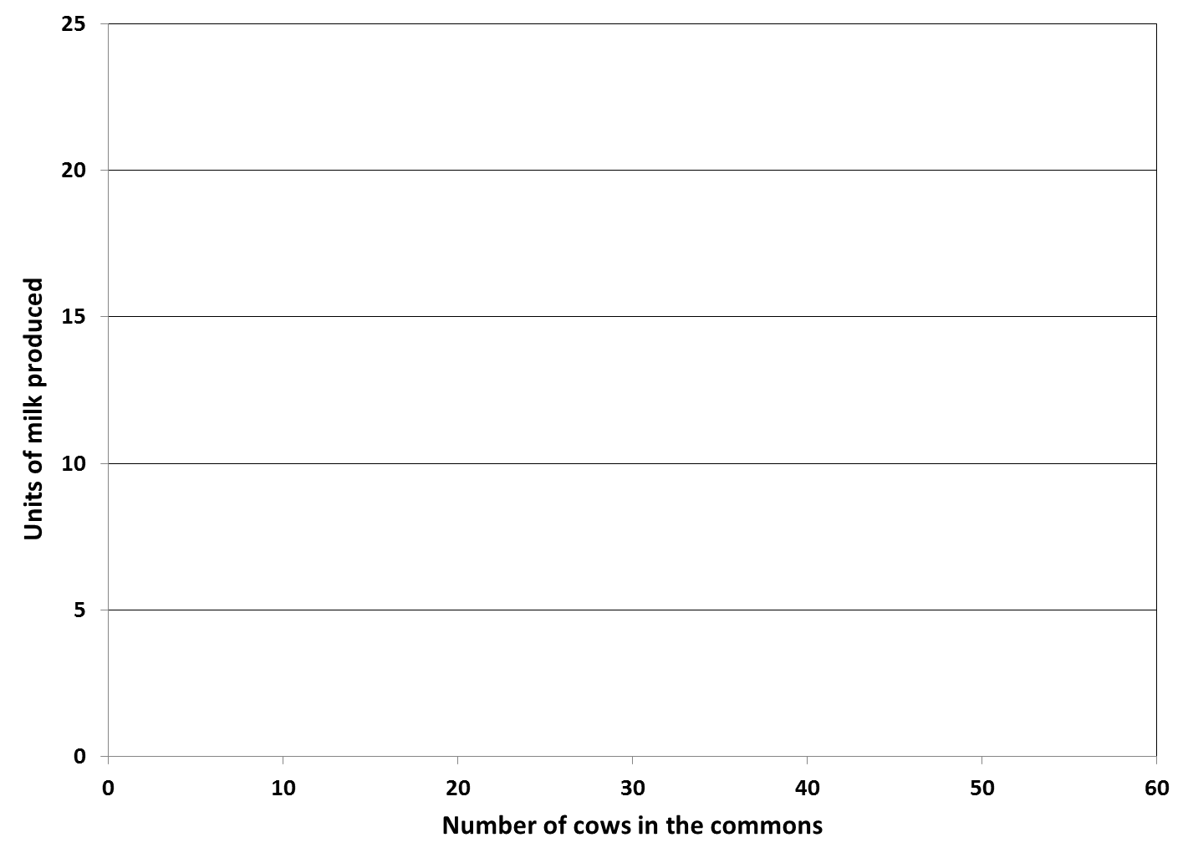

Slide 2
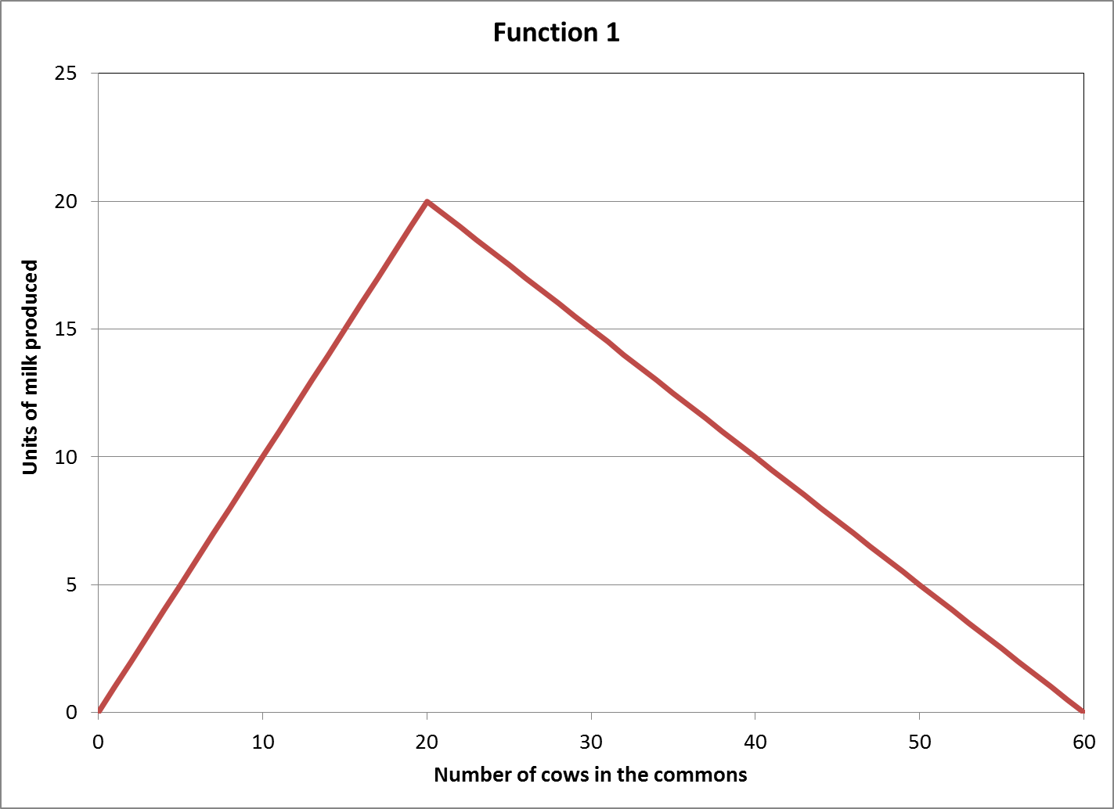
$$f\left(N\right)=\left\{\begin{matrix}N & if 0≤N≤20 \\ 20−\frac{N−20}{2} & if 20<N≤60\end{matrix}\right.$$
Turning point

Slide 3
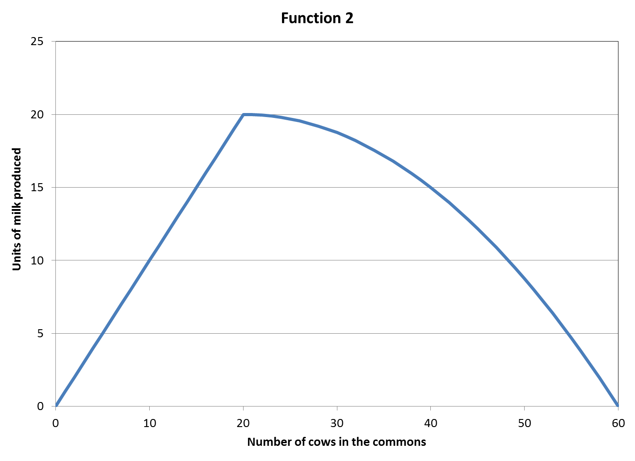
$$f\left(N\right)=\left\{\begin{matrix}N & if 0≤N≤20 \\ 20\left(1−\frac{{\left(N−20\right)}^{2}}{1600}\right) & if 20<N≤60\end{matrix}\right.$$

Slide 4
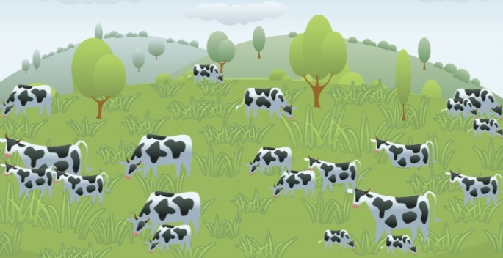
Aggregated Level
Total number of cows: 20
Total milk production: 20 units
Farmer Level
All farmers:
Number of cows: 2
Milk production: 2 units

Slide 5
Aggregated Level
Total number of cows: 21
Total milk production: 19.99 units
Farmer Level
Farmer 1:
Number of cows: 3
Milk production: 2.86 units
All other farmers:
Number of cows: 2
Milk production: 1.90 units

Slide 6
Aggregated Level
Total number of cows: 30
Total milk production: 18.75 units
Farmer Level
All farmers:
Number of cows: 3
Milk production: 1.88 units

Slide 7
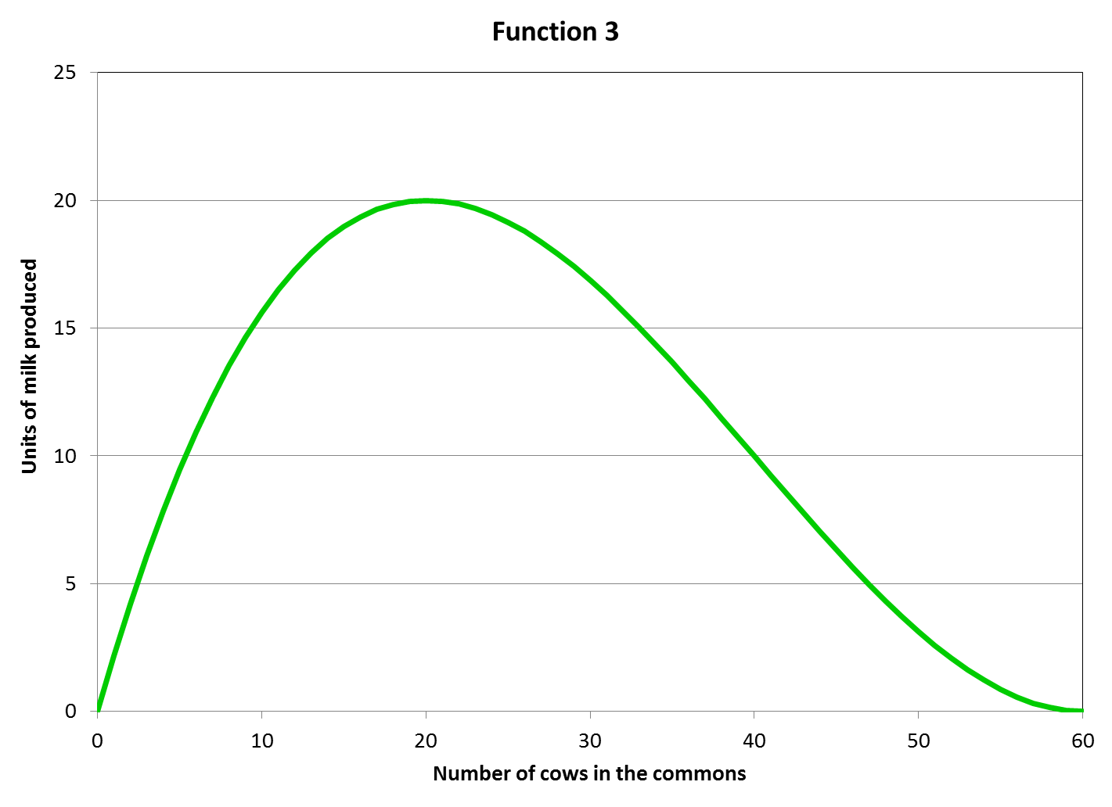
$$f\left(N\right)=\frac{N}{4}\left(\frac{N^{2}}{400}−\frac{3N}{10}+9\right) if 0≤N≤60$$

Slide 8
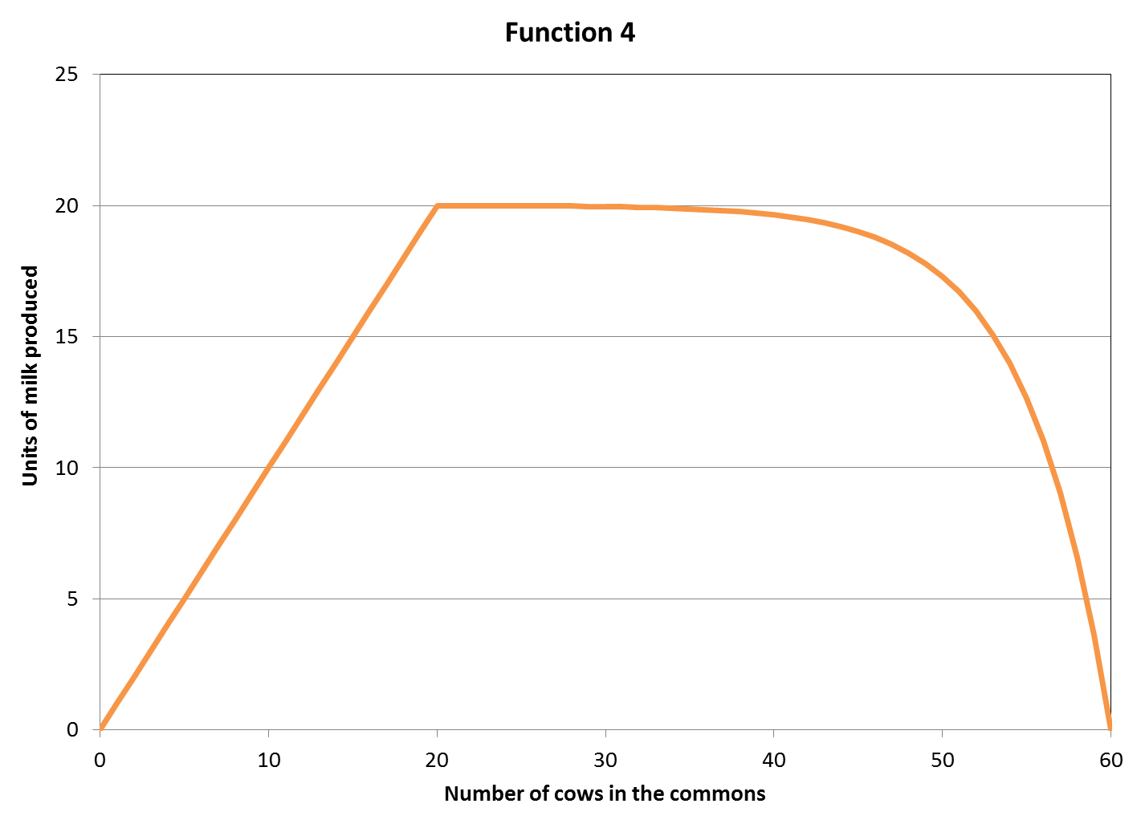
$$f\left(N\right)=\left\{\begin{matrix}N & if 0≤N≤20 \\ 20\left(1−e^{−0.2\left(60−N\right)}\right)/(1−e^{−8}) & if 20<N≤60\end{matrix}\right.$$

